Slide 1

Paris Convention for the Protection of Industrial Property
Christine Bonvallet
WIPO – AIPLA 20th Annual PCT Seminar, July 2016

Slide 2
Priority date and priority period
(PCT Article 2(xi) and Rule 2.4)
The priority date for the purposes of computing time limits means:
  where the international application contains a priority claim, the filing date of the application whose priority is claimed
  where the international application contains several priority claims, the filing date of the earliest application whose priority is claimed
  where the international application does not contain any priority claim, the international filing date
The “priority period” is the period of 12 months from the filing date of the earlier application whose priority is claimed
  the day of filing of the earlier application is not included in that period

Slide 3
Claiming priority
(PCT Article 8, Rule 4.10)
The conditions for and the effects of any priority claim are as provided in Article 4 of the Stockholm Act of the Paris Convention for the Protection of Industrial Property
The international application may contain a declaration claiming the priority of one or more earlier applications
  filed in or, by way of a regional or international application, for any country party to the Paris Convention and/or
  filed in any Member of the World Trade Organization (WTO) that is not party to the Paris Convention

Slide 4
Paris Convention
Article 4 – Paragraph A
A. — (1) Any person who has duly filed an application for a patent, or for the registration of a utility model, or of an industrial design, or of a trademark, in one of the countries of the Union, or his successor in title, shall enjoy, for the purpose of filing in the other countries, a right of priority during the periods hereinafter fixed.
(2) Any filing that is equivalent to a regular national filing under the domestic legislation of any country of the Union or under bilateral or multilateral treaties concluded between countries of the Union shall be recognized as giving rise to the right of priority.
(3) By a regular national filing is meant any filing that is adequate to establish the date on which the application was filed in the country concerned, whatever may be the subsequent fate of the application.

Slide 5
Paris Convention (2)
Article 4 - Paragraph B
B. —Consequently, any subsequent filing in any of the other countries of the Union before the expiration of the periods referred to above shall not be invalidated by reason of any acts accomplished in the interval, in particular, another filing, the publication or exploitation of the invention, the putting on sale of copies of the design, or the use of the mark, and such acts cannot give rise to any third-party right or any right of personal possession. Rights acquired by third parties before the date of the first application that serves as the basis for the right of priority are reserved in accordance with the domestic legislation of each country of the Union.

Slide 6
Paris Convention (3)
Article 4 - Paragraph C
C. — (1) The periods of priority referred to above shall be twelve months for patents and utility models, and six months for industrial designs and trademarks.
(2) These periods shall start from the date of filing of the first application; the day of filing shall not be included in the period.
(3) If the last day of the period is an official holiday, or a day when the Office is not open for the filing of applications in the country where protection is claimed, the period shall be extended until the first following working day.
(4) A subsequent application concerning the same subject as a previous first application within the meaning of paragraph (2), above, filed in the same country of the Union, shall be considered as the first application, of which the filing date shall be the starting point of the period of priority, if, at the time of filing the subsequent application, the said previous application has been withdrawn, abandoned, or refused, without having been laid open to public inspection and without leaving any rights outstanding, and if it has not yet served as a basis for claiming a right of priority. The previous application may not thereafter serve as a basis for claiming a right of priority.

Slide 7
Paris Convention (4)
Article 4 - Paragraph D
D. — (1) Any person desiring to take advantage of the priority of a previous filing shall be required to make a declaration indicating the date of such filing and the country in which it was made. Each country shall determine the latest date on which such declaration must be made.
(2) These particulars shall be mentioned in the publications issued by the competent authority, and in particular in the patents and the specifications relating thereto.
(3) The countries of the Union may require any person making a declaration of priority to produce a copy of the application (description, drawings, etc.) previously filed. The copy, certified as correct by the authority which received such application, shall not require any authentication, and may in any case be filed, without fee, at any time within three months of the filing of the subsequent application. They may require it to be accompanied by a certificate from the same authority showing the date of filing, and by a translation.
(4) No other formalities may be required for the declaration of priority at the time of filing the application. Each country of the Union shall determine the consequences of failure to comply with the formalities prescribed by this Article, but such consequences shall in no case go beyond the loss of the right of priority.
(5) Subsequently, further proof may be required. Any person who avails himself of the priority of a previous application shall be required to specify the number of that application; this number shall be published as provided for by paragraph (2), above.

Slide 8
Paris Convention (5)
Article 4 - Paragraphs E and F
E. — (1) Where an industrial design is filed in a country by virtue of a right of priority based on the filing of a utility model, the period of priority shall be the same as that fixed for industrial designs.
(2) Furthermore, it is permissible to file a utility model in a country by virtue of a right of priority based on the filing of a patent application, and vice versa.
F. — No country of the Union may refuse a priority or a patent application on the ground that the applicant claims multiple priorities, even if they originate in different countries, or on the ground that an application claiming one or more priorities contains one or more elements that were not included in the application or applications whose priority is claimed, provided that, in both cases, there is unity of invention within the meaning of the law of the country. With respect to the elements not included in the application or applications whose priority is claimed, the filing of the subsequent application shall give rise to a right of priority under ordinary conditions.

Slide 9
Paris Convention (6)
Article 4 - paragraphs G and H
G. — (1) If the examination reveals that an application for a patent contains more than one invention, the applicant may divide the application into a certain number of divisional applications and preserve as the date of each the date of the initial application and the benefit of the right of priority, if any.
(2) The applicant may also, on his own initiative, divide a patent application and preserve as the date of each divisional application the date of the initial application and the benefit of the right of priority, if any. Each country of the Union shall have the right to determine the conditions under which such division shall be authorized.
H. — Priority my not be refused on the ground that certain elements of the invention for which priority is claimed do not appear among the claims formulated in the application in the country of origin, provided that the application documents as a whole specifically disclose such elements.

Slide 10
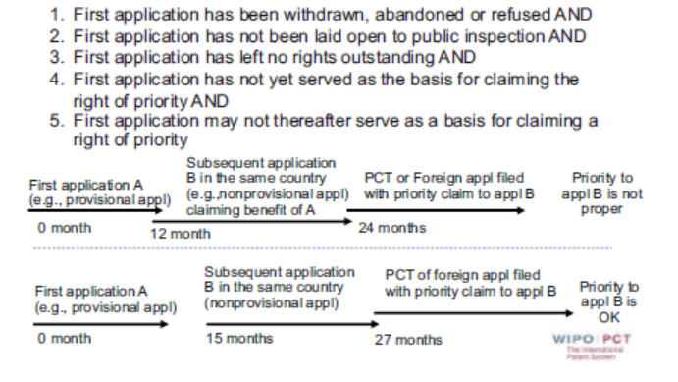
When is a subsequent application concerning the same subject matter considered the first application within the meaning of Article 4 C (A)?

Slide 11
Different language in the U.S. Statues than in the Paris Convention
35 U.S.C. 21(b) states
When the day or the last day, for taking any action or paying any fee in the United States Patent and Trademark Office falls on Saturday, Sunday or a Federal holiday within the District of Columbia, the action may be taken or fee paid on the next succeeding secular or business day
35 U.S.C. 119(e)(3) states:
If the day that is 12 months after the filing date of a provisional application falls on a Saturday, Sunday or Federal holiday within the District of Columbia, the period of pendency of the provisional application shall be extended to the next secular or business day
Under US law applicants are permitted to take action on the next business day when the last day for taking action falls on a weekend or Federal holiday, regardless of the mode or form of filing

Slide 12
Possible legal consequences of the USPTO accepting electronic applications on Saturday and Sunday
International applications (or any other patent document) can be filed electronically in the USPTO during the hours of operation of EFS-Web every day of the week, including weekends and holidays
Paris Convention Article 4C(3) says “If the last day of the period is an official holiday, or a day when the Office is not open for the filing of applications in the country where protection is claimed, the period shall be extended until the first following working day”
Applicants should consider possible adverse consequences regarding the validity of a Paris Convention priority claim if they wait until Monday to file an international application in the RO/US where the priority year ends on a Saturday or Sunday

Slide 13
Furnishing of priority documents
(Rule 17.1)
Where the priority of an earlier national, regional or international application is claimed, the applicant must provide a priority document for each corresponding earlier application (that is, a certified copy of the earlier application)
  by furnishing such document directly to the receiving Office or the International Bureau (Rule 17.1(a)), or
  by requesting the receiving Office to prepare such document and transmit it to the IB (Rule 17.1(b)), if the earlier application was filed with that Office, or
  by requesting the IB to obtain the priority document from a digital library (Rule 17.1(b-bis)) (only for Offices participating in the Digital Access Service (DAS)

Slide 14
Time limit for the furnishing of priority documents (Rule 17.1)
Direct submission by the applicant to the RO:
  within 16 months from the priority date
Direct submission by the applicant to the IB:
  before international publication
Request to the RO to prepare and transmit the priority document to the IB:
  within 16 months from the priority date
Submission via DAS to IB:
  The priority document must be made available to the IB via DAS and the request to the IB to retrieve the priority document must be made before international publication

Slide 15
Retrieval of priority documents via DAS
Possibility to request the IB to retrieve a copy of the priority document of an earlier application, in electronic form, via DAS
The service is available for earlier national applications filed with AU, CN, DK, ES, FI, GB, JP, KR, NZ, SE and US and for earlier international applications filed with AU, CN, DK, ES, FI, SE and RO/IB
The Office with which the earlier national application was filed is known as the Office of First Filing (OFF) or the Depositing Office
The Office that retrieves the document is known as the Office of Second Filing (OSF) or Accessing Office

Slide 16
Main steps for the use of DAS
Request the OFF to make the earlier application available via DAS
The OFF (or, in some cases, the IB on behalf of the OFF) provides the applicant with an access code
File the PCT international application and request the IB to retrieve the priority document via DAS by checking the appropriate box on the request form and include the access code
The IB retrieves the priority document via DAS and sends a confirmation of retrieval to the applicant by means of the Form PCT/IB/304

Slide 17
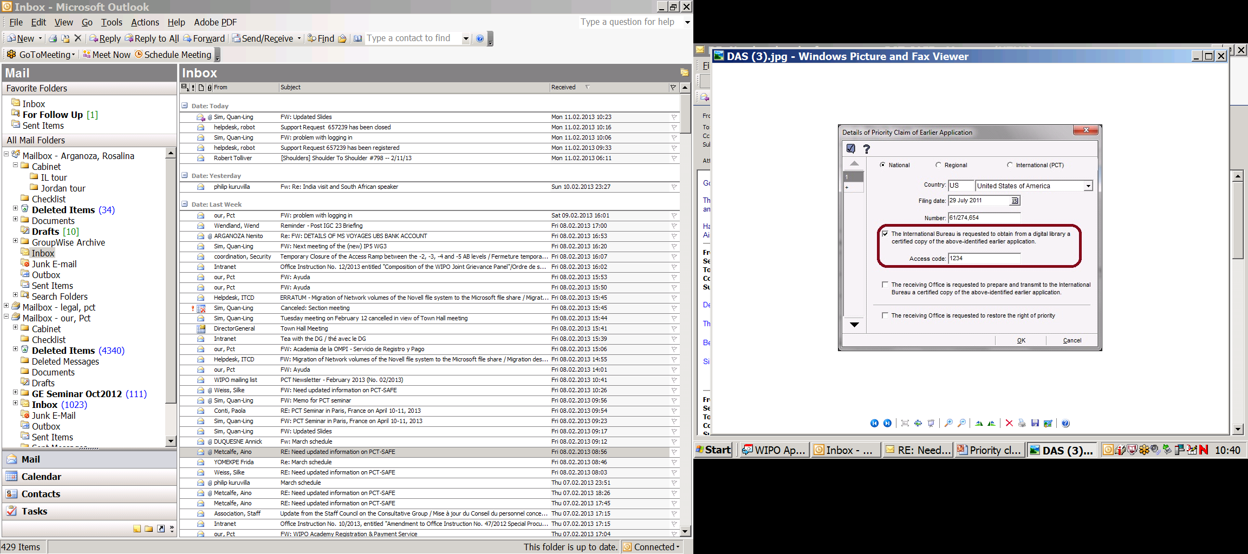

Requesting DAS p-doc retrieval
Select the checkbox on the Priority details page for the corresponding priority claim and indicate the access code.

