Slide 1

Picking an International Searching Authority
TM
Jay Erstling
July 2016

Slide 2
Picking an International Searching Authority
You are getting ready to file a PCT application
You (the client) must pick an International Searching Authority (ISA)
If your habit is always to pick the same ISA, because “we've always done it that way,” then this is an opportunity to provide better service to your client

Slide 3
Which ISA can you choose?
The Receiving Office (RO) at which you file determines the available ISAs
  To be a competent RO, at least one applicant must be a national/resident of the country/region of that RO
  Any applicant can file at the RO/IB
If you file at the RO/IB, the available ISAs are any that you could have selected if you had filed your application at the competent national/regional RO
If there are joint applicants from different countries, you can file at any competent RO, but the RO you choose will determine the available ISAs
  Therefore, best to consider available ISAs when selecting the RO
  If you choose the RO/IB, you get to choose from the combined available ISAs

Slide 4
Which ISA can you choose?
You can include an applicant of another nationality for the purpose of enabling filing at another RO (applicant of convenience)
  The extra applicant can be made an applicant only for one obscure country
You can use PCT-SAFE File Manager (for RO/US) or ePCT (for RO/IB) to prepare your Request. The software will look at the applicants and will tell you if you picked a competent RO, and will tell you which ISAs you can pick

Slide 5
You picked RO/US?
There are 21 ISAs in total
Available ISAs if you filed at the RO/US:
  AU (Australia)
  EP (EPO)
  RU (Russia)
  SG (Singapore)
  IL (Israel)
  JP (Japan)
  KR (South Korea)
  US (USPTO)

Slide 6
Factors to Consider in Choosing an ISA
PPH benefit
Cost
Timeliness
Effect on later national/regional stage
Characteristics of ISRs from the different ISAs
Language competency
Who does the work (outsourcing)
Provision of cited references
Competencies
Keep in mind that some clients do not care at all about the ISR/WO

Slide 7
PPH Benefit
AU, IL, JP, KR, RU, SG, and US are all part of the Global PPH pilot. Positive results from any of those ISAs may form the basis for PPH status in:
  AT, AU, CA, DE, DK, EE, ES, FI, GB. HU, IL, IS, JP, KR, NO, PT, RU, SE, SG, US
EP, JP, KR, and US are part of the IP5 PPH pilot. Positive results from any of those ISAs may form the basis for PPH status in:
  CN, EP, JP, KR, US
So if you know now in which Offices you might enter national/regional phase, and if you might want PPH benefit in those Offices, this may influence your choice of ISA

Slide 8
EPO and PPH
Note that EPO has the PACE program, which offers the opportunity to accelerate search or examination without having to qualify for PPH
PPH is generally ineffective with EPO as the Office of Later Examination, but can be effective elsewhere with EPO as the Office of Earlier Examination.

Slide 9
Search Fees as of June 1, 2016
AU: $1,674 (second and subsequent inventions ≈ $1,674 each)
EP: $2,097 (second and subsequent inventions ≈ $2,097 each)
IL: $912 (second and subsequent inventions ≈ $912 each)
JP: $1,378 (second and subsequent inventions ≈ $1,209 each)
KR: $1,120 (second and subsequent inventions KRW 225,000 each ≈ $192)
RU: $420 (second and subsequent inventions ≈ $420 each)
SG: $1,578 (second and subsequent inventions ≈ $1,662 each)
US: $2,080 (second and subsequent inventions $2,080 each)
  $1,040 if the applicant is a small entity (second and subsequent inventions $1,040 each)
  $520 if the applicant is a micro-entity (second and subsequent inventions $520 each)
Notes:
9

Slide 10
Additional Search Fees in the Event of Lack of Unity of Invention
Where there is lack of unity, the ISA will only search the first invention
To have the additional inventions searched, applicant has to pay an additional search fee for each invention in the ISA’s local currency
Consider the comparative cost of search if there is a likelihood of lack of unity
  If you think you are likely to have multiple inventions, consider ISA/KR

Slide 11
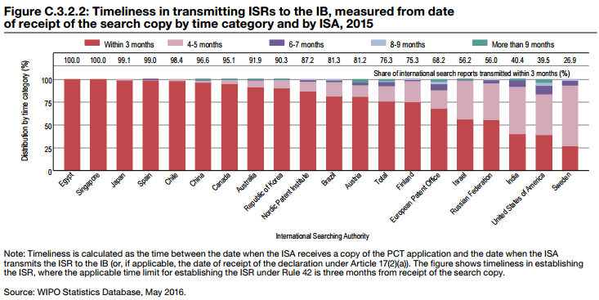
Timeliness in 2015

Slide 12
Timeliness
Ranking among ISAs available to RO/US filers:
  ISA Share transmitted within 3 months
  SG 100%
  JP 99.1%
  AU 91.9%
  KR 90.3%
  EP 68.2%
  IL 56.2%
  RU 56.0%
  US 39.5%
Offices below the overall average: EP, IL, RU, US
But in overwhelming majority of cases, the ISR is transmitted within 4-5 months of receipt of the search copy

Slide 13
Effect on Later National/Regional Stage
If you pick ISA/EP and later enter the EP regional phase, you don’t have to pay a search fee to the DO/EP
  EPO “drinks its own Champagne”
If you pick ISA/US and get a favorable WO, or pick IPEA/US and get a favorable IPRP (Chapter II), and you later enter the US national stage, you get out-of-order examination and reduced search and examination fees (37 CFR 1.496)
If you pick IPEA/AU, you get a reduced examination fee in EO/AU

Slide 14
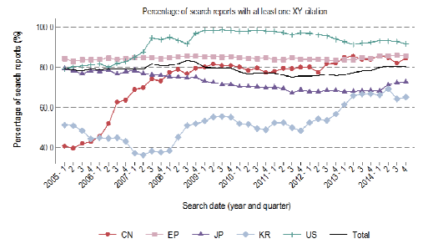
Characteristics of ISRs
Source: WIPO Circular C. PCT 1463 (December 18, 2015) http://www.wipo.int/export/sites/www/pct/en/circulars/2015/1463-e-annex.pdf
X/Y Citation Rate

Slide 15
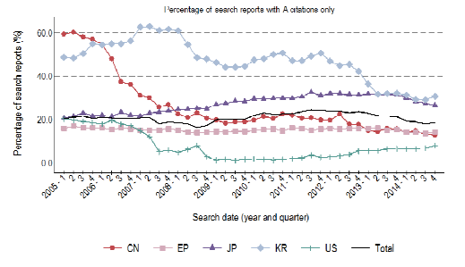
Characteristics of ISRs
A Citation Only Rate

Slide 16
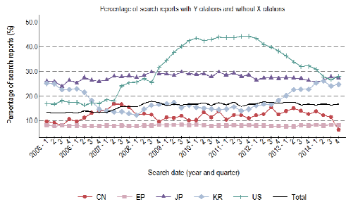
Characteristics of ISRs
Y Without X Citation Rate

Slide 17
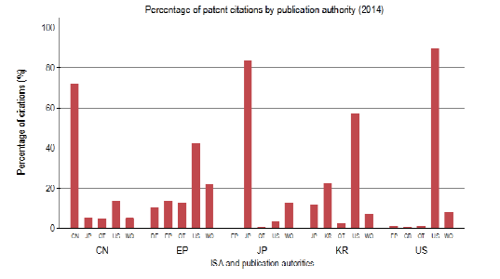
Characteristics of ISRs
Choice of Citations

Slide 18
Language Competency
An ISA/AU or ISA/US searcher might read only English
ISA/EP searchers read at least English, German, and French, and some also read additional languages
ISA/IL searchers read Hebrew and English and most also read Russian
ISA/JP searchers read Japanese and English
ISA/KR searchers read at least Korean and English and most also read Japanese
ISA/RU searchers read at least Russian and English and some also read additional languages
ISA/SG searchers read English and Mandarin and some also read additioal languages

Slide 19
Excluded Subject Matter and Subject Matter Not Required to be Searched
An International Authority may exclude certain subject matter from its agreement with WIPO to act as an ISA and IPEA
  If all the claims are directed to such subject matter, ISA will issue an Article 17(2)(a) declaration of non-establishment of the ISR
  Subject matter not required to be searched includes (Rule 39.1)
    Scientific and mathematical theories
    Plant or animal varieties or essentially biological processes for the production of plants or animals (except microbiological)
    Schemes, rules or methods of doing business
    Methods for the treatment or diagnosis of the human or animal body
    Mere presentations of information
    Computer programs
Notes:
19

Slide 20
Subject Matter Not Searched
For example:
  AU
    Methods of treatment
    Plant and animal varieties
  KR
    Methods of treatment of the human body by therapy
  RU
    Methods of doing business
    Software per se
    BUT RU does search methods of treatment of the human or animal body by surgery or therapy, as well as diagnostic methods (PCT Rule 39.1 (iv))

Slide 21
ISA Competency Considerations (1)
ISA/AU
  Not competent to act as ISA for international applications filed by US applicants in RO/US or RO/IB if:
    More than 250 IAs have been received in the relevant fiscal quarter
ISA/EP
  As of January 1, 2015, competent to act as ISA for Ias filed by US applicants in RO/US or RO/IB without any competency restrictions
    Including claims directed to business methods involving technical means
    ISA/EP will not search claims directed to mere business methods
      For details, see: http://documents.epo.org/projects/babylon/eponet.nsf/0/fe9b7f7048bf6529c1257d7900469114/$FILE/No_more_limitations_to_PCT_work_en.pdf

Slide 22
ISA Competency Considerations (2)
ISA/IL
  Not competent to act as ISA for IAs filed by U.S. applicants in RO/IB
  Not competent to act as ISA for IAs filed by U.S. applicants in RO/US with
    one or more claims directed to business methods
      restriction eliminated 10 April 2016
    Numerical limitation of no more than 75 100 IAs per fiscal quarter
      Number increased from 10 April 2016

Slide 23
ISA Competency Considerations (3)
ISA/JP
  The following restrictions apply:
    the applications are submitted in the English language;
    the claims of the application are directed to the field of green technology as defined by certain International Patent Classification classes;
    Quota has not yet been met
      Not to exceed 5,000 international applications from the USPTO during the 3 year period from July 1, 2015 to June 30, 2018
      Not more than 300 applications per quarter during the first year
      Not more than 475 application per quarter during the second and third years

Slide 24
EP: Limitation on Number of Independent Claims in a Category
Where there are two or more independent claims in the same category of invention (i.e., product or method) that are in unity of invention:
  ISA/EP may issue an informal communication telling the applicant that the description, claims or drawings fail to comply with the PCT requirements to such an extent that a meaningful search cannot be carried out because the plurality of independent product claims lack conciseness as required by PCT Article 6
  The applicant may need to choose which independent claim should be searched
  Unlike a unity of invention requirement, the applicant cannot pay for the search of the other independent claims in that category
  Best to ensure that most important independent claim is listed first

Slide 25
Outsourcing
ISA/US searches are outsourced
  Continued user concern that USPTO examiners in US national phase may not give full faith and credit to outsourced ISA/US searches and written opinions
  USPTO focus on ensuring the quality of work from ISA/US contractor

Slide 26
Provision of Cited References
Upon payment or free of charge
  ISA/AU: upon payment of AUD 50 (about $37) per document
  ISA/EP: provides copies of cited references
  ISA/IL: upon payment of ILS 43 (about $11) per document
  ISA/JP: upon payment of JPY 1400 (about $14) per document
  ISA/KR: provides a temporary link to a web page containing electronic copies of cited references
  ISA/RU: provides copies of cited documents
  ISA/SG: upon payment of SGD 30 (about $ 22) per document
  ISA/US: provides copies of cited non-US patent documents and non-patent literature

Slide 27
Choice of ISA for International Applications filed in
RO/US
 | ISA/US | ISA/EP | ISA/KR | ISA/AU | ISA/RU | ISA/IL | ISA/JP | ISA/SG
FY2010 | 33% | 37% | 29% | 1% | N/A | N/A | N/A | N/A
FY2011 | 34% | 35% | 30% | 1% | N/A | N/A | N/A | N/A
FY2012 | 32% | 35% | 31% | <1% | 2% | N/A | N/A | N/A
FY2013 | 29% | 38% | 29% | <1% | 4% | N/A | N/A | N/A
FY2014 | 32% | 37% | 27% | <1% | 3% | <1% | N/A | N/A
FY2015 | 36% | 37% | 24% | <1% | 2% | <1% | <1% | N/A
FY2016 to date | 37% | 37% | 22% | <1% | 3% | 1% | <1% | 0%

Slide 28
Supplementary International Search
The applicant can ask another ISA to do its own search in addition to the standard ISA search, if the other ISA allows it
  Most ISAs do not allow SIS, but:
    EP, RU, SG, AT, FI, SE, UK, XN, XV offer it
  Deadline to request SIS is 19 months from priority
  Supplementary search fee to be paid to IB
  SIS Report is produced by the SISA
  Benefits
    Reduces risk of new prior art being cited in the national phase
    Can expand the linguistic and technical scope of the search
Result of using EPO as SISA is that when entering European regional phase, the application will be treated in same manner as if EPO had been the ISA

Slide 29
International Preliminary Examining Authority
Your choice of ISA affects your later choice of an IPEA
  AU/EP/IL/JP/SG will be available as IPEA to the US filer in a particular PCT application only if that IPEA was also the ISA
    Bear this in mind when selecting an ISA

Slide 30
Questions?
Jay Erstling | 612-349-5771 | erstling@ptslaw.com

